Slide 1


Machine Learning Assignment 2
Tsarouchas Nikolaos-Marios

Slide 2
Pipeline
Definition of the Problem
Credit Card Approval
Exploratory Data Analysis
EDA
Get to know your data, Descriptive statistics, histograms, distribution plots, missing values, outlier detection, duplicate values
Data Preprocessing
Data cleaning (duplicates, missing values, redundant data, outliers)
Feature Engineering &
Selection
Feature Scaling, Data imputation, Feature engineering and feature selection, Data augmentation
Model
Selection
Split data, train model on cross validation, hyperparameter tuning
Model
Evaluation
Evaluate model performance on test set (Precision recall, ROC ,PR curve, Confusion matrix)

Slide 3
Problem Definition
Credit score cards are a common risk control method in the financial industry. It uses personal information and data submitted by credit card applicants to predict the probability of future defaults and credit card borrowings.
Two dataset were given:
the first one with customers application information and
the second one with credit information history per customer.
The task is to build a machine learning algorithm to predict if an applicant for credit card is classified as ‘Approval’ or ‘Non_approval’ client.
Credit score cards are based on historical data. Once encountering large economic fluctuations. Past models may lose their original predictive power. Logistic regression is commonly used for such problems.
With the development of machine learning, more sophisticated models have been introduced into credit card scoring.

Slide 4
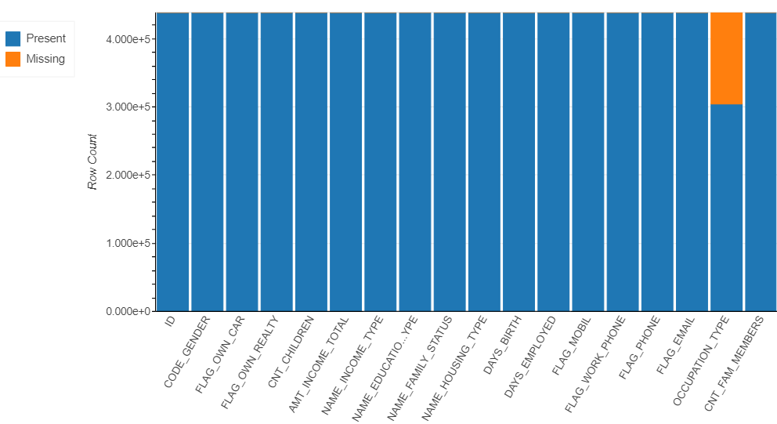
EDA
There are 348.472 records with different ids but duplicate values for all the rest features. (90.085 unique ids)
Feature FLAG_MOBIL is constant equal to 1 (redundant)
~30% of occupation feature values are missing
ID has no insight for the task apart from connecting the datasets
ID: Client number Numerical
CODE_GENDER: gender Categorical
FLAG_OWN_CAR: Is there a car Categorical
FLAG_OWN_REALTY: Is there a property Categorical
CNT_CHILDREN: Number of children Categorical
AMT_INCOME_TOTAL: Annual income Numerical
NAME_INCOME_TYPE: Income category Categorical
NAME_EDUCATION_TYPE: Education level Categorical
NAME_FAMILY_STATUS: Marital status Categorical
NAME_HOUSING_TYPE: Way of living Categorical
DAYS_BIRTH: Days from birth Numerical
DAYS_EMPLOYED: Day working Numerical
FLAG_MOBIL: Is there a mobile phone Binary
FLAG_WORK_PHONE: Is there a work phone Binary
FLAG_PHONE: Is there a phone Binary
FLAG_EMAIL: Is there an email Binary
OCCUPATION_TYPE: Occupation Categorical
CNT_FAM_MEMBERS: Family size Categorical
Application record
Initial Shape
R: 438.557
C: 18
There are 9.709 applications with credit info
Credit record
There are no missing values in the attributes.
There are no duplicates in the whole dataset, however there are in the subset (Months_Balance, Status), but is possible for a customer to have the same credit score in a month.
There are 45.985 unique ids
ID has no insight for the task apart from connecting the datasets
Initial Shape
R: 1.048.557
C: 3
ID: Client number Numerical
MONTHS_BALANCE: month of the record Numerical
STATUS: on time payment, overdue in days, bad debt Categorical

Slide 5

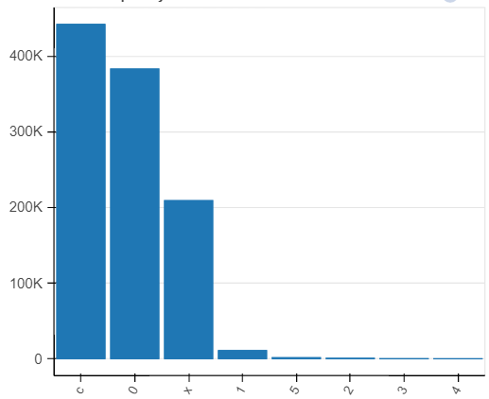
EDA
Deeper dive in Credit record dataset
Descriptive statistics
For a bank, customers who pay always on time are classified in Bank terms as “Shipwrecks”, since they do not pay any interest which is the income for the bank.
Status Feature
We have historical information (monthly) concerning the credit score per person This information given in Status feature are going to be used for creating the classes.
As we can see the majority of the instances fall under the category of X, C, 0 which indicate low credit risk. Thus no matter what strategy we will choose to proceed with in the classification we shall face an extreme imbalanced dataset.
0: 1-29 days past due
1: 30-59 days past due
2: 60-89 days overdue
3: 90-119 days overdue
4: 120-149 days overdue
5: Overdue or bad debts, write-offs for more than 150 days
C: paid off that month
X: No loan for the month
As Strategy it was chosen to take the mean score per id, considering X and C as 0, and if this value is greater than 2 (overdue above 60 days) will be classified as non-approval.

Slide 6
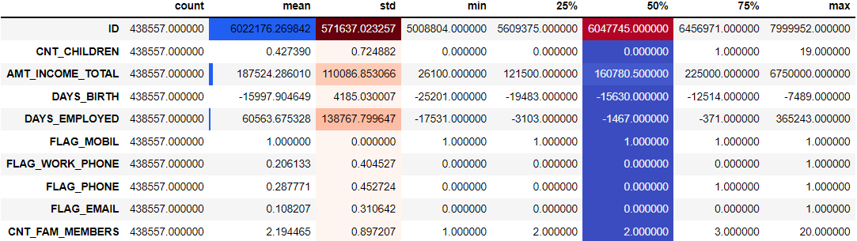
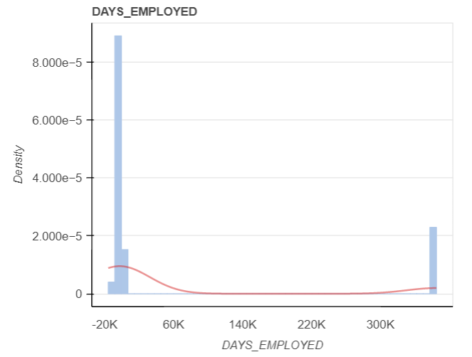
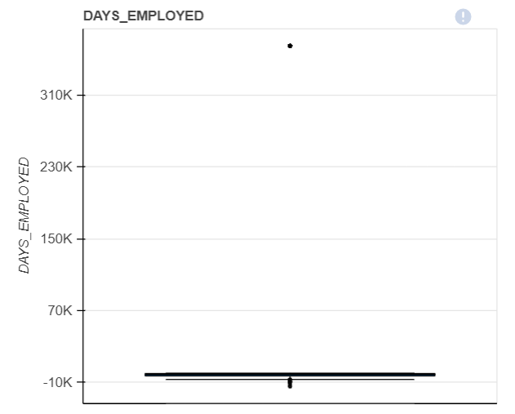
EDA
Deeper dive in Application record
Descriptive statistics
key takeaways
Based on DAYS_EMPLOYED feature there are 1696 employees working for more than 160 years. As can be seen in they from density plot they belong in the same bin and thus they seem to be collective outliers.
AMT_INCOME feature tests indicate that they might have outliers, but taking into account the amounts it seems plausible to be legit Incomes.
In the consolidated dataset consisting of 9709 instances 9503 are annotated as approval (majority class) and 206 as non-approval (minority class).
Outliers in DAYS_EMPLOYED indicate 1696 instances, out of which 51 are annotated as non-approval. We decide that we can lose any instance of the minority class and we will replace the values with NaN for now.
Missing values in OCCUPATION_TYPE are 2994, out of which 74 are annotated as non-approval. Once more we decide not to drop any instance and proceed with imputation similar with DAYS_EMPLOYED.
Outlier Detection
Skewness
In Skewed data, the tail region may act as an outlier for the statistical model and we know that outliers adversely affect the model’s performance especially regression-based models. Thus, we will proceed with smoothing through discretization.
Feature | Skewness | Insight
CNT_CHILDREN | 1.994812 | Skewed
AMT_INCOME_TOTAL | 7.915335 | Skewed
DAYS_EMPLOYED | 1.717701 | Skewed
CNT_FAM_MEMBERS | 1.005251 | Skewed

Slide 7
Data Preprocessing
Feature Engineering
Remove duplicate values
Remove ‘ID’ and ‘FLAG_MOBIL’ since they are redundant
Dealing with duplicate values
Status
Assign 0 where values are ‘X’ or ‘C’.
Take the mean value per month for every id
Classify as non-approval values where debts are overdue for over 60 days
Replace outliers with NaN in feature Days employeed using the interquartile range (IQR)
IQR = Q3-Q1
lower_bound = Q1 - (1.5* IQR)
upper_bound = Q3 + (1.5* IQR)
Occupation
Create 4 clusters for occupation type as follows:
Lower
Medium
Higher
Manager
Dealing with Outliers
Imputation Strategy for the missing values:
Replace with mean value for days of employment
Replace randomly keeping the same distribution for Occupation
Days (Birth, Employed)
Convert days into years
Imputation Techniques
Discretization
KBinsDiscretizer is applied in:
family members (Create 3 clusters)
number of children (Create 3 clusters)
Income (Create 10 clusters)
Age (Create 3 clusters)
Years employed (Create 10 clusters)
PCA
Principal Component Analysis performed in the final data set after the application of feature transformation. The first 30, 10 and 7 principal components were kept for future use.
Ordinal Encoding
Applied in binary features (Gender, flag_car and flag own realty) and in the categorical features to convert text into values.
Feature transformation & Scaling
One-hot encoding
Applied in all categorical values

Slide 8
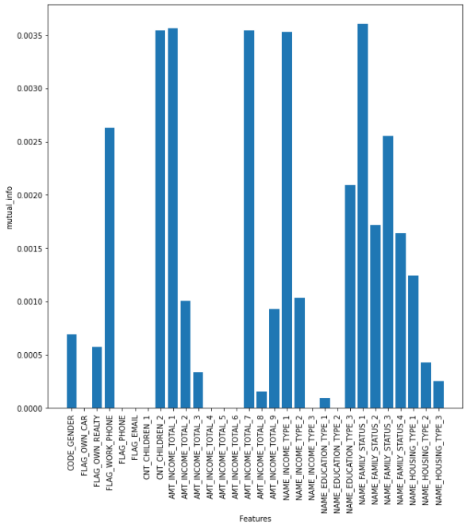
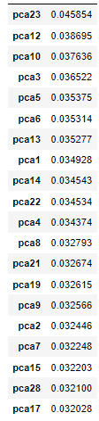
Feature Selection
Feature Selection is applied before dealing with imbalanced data set because we want independence among the variables and after the application of oversampling the independence will not hold. However , with undersampling it might go either way
The Statistical filter method of mutual information was used in the dataset features, witch measures the mutual dependence of two variables.
Extratree Classifier was used in the dataset, from which Feature importance was extracted
Filter
methods
Wrapper
methods
Embedded
methods
The Recursive feature elimination was used in the dataset with the SVC as an estimator and f1 (harmonical mean of precision & recall ) as the scoring since we have an extreme imbalanced data set.
Feature selection applied both in original dataset and in the principal components

Slide 9
Model Selection
01
Split data
The data were split into three sets : train, validation and hold out (unseen test set)
Dealing with imbalanced dataset:
Use of SMOTE, ADASYN for oversampling.
Use of Tomek Links, NearMiss and random undersampling.
02
Train various models using cross validation in train and validation datasets. Models used (Linear Regression, LDA, KNN, Decision Tree, Naïve Bayes, SVC, Random Forest, Gradient Boosting, XGB) [f1_weighted used in scoring].
Oversampling
Undersampling
03
04
Hyperparameter tuning for the winner algorithm in order to achieve the best possible results.
All features
Selected features/
Principal components
Selected features/
Principal components
05
Final evaluation of the selected model using various metrics in order to achieve robustness.
All features

Slide 10
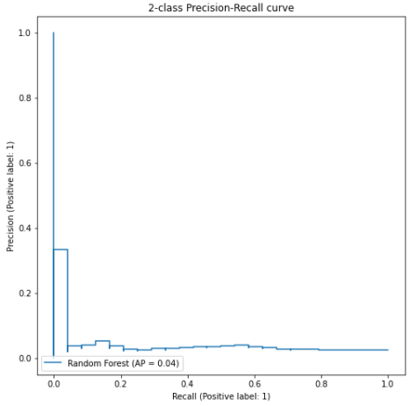
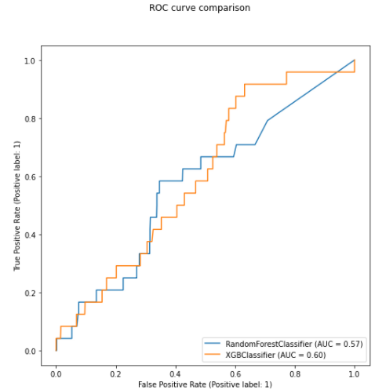
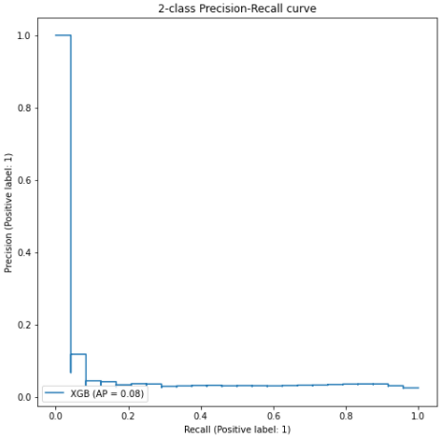
Model Evaluation
Oversampling
Even though it seems that the model would work on unseen data it seems that they completely fail to generalize.
As far as the model capacity is concerned it seems that the models learned by heart the data and thus they overfit.
In order to overcome the problem of overfitting we tried apart from what we have done until know the following:
Feature elimination
Use the principal components
Undersample the data
ROC curve is not a good measure for imbalance data and are optimistic compared to PRC

Slide 11
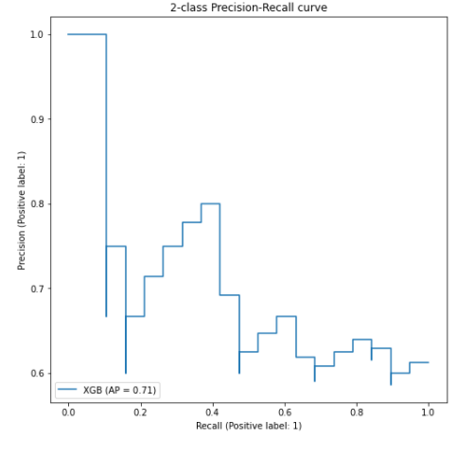
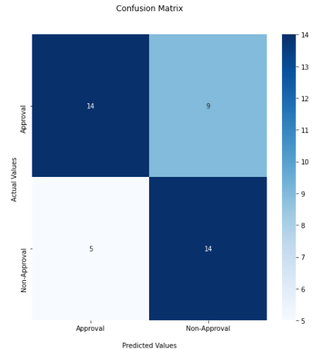
Model Evaluation
Random undersampling
The best results were given by XGB taking into account all the features with random undersampling
The model generalizes better than before however the results are moderate since the f1 score is ~0,7.

Slide 12

Conclusions
The biggest problem of the problem was the imbalanced data.
Data were not cleaned and needed cleaning and many transformations.
Lack of expertise knowledge may be another big issue, leading to wrong decisions regarding annotation. Another strategy may lead to better solutions.
ML techniques is a great arsenal, however expertise in the problem field and appropriate data play a crucial role.

Slide 13
Thank you!!!

